Slide 1
SECURE DATA HIDING IN IMAGES USING STEGANOGRAPHY
CAPSTONE PROJECT
Student Name : Vemula Nithin Murali
College Name & Department : Holy Mary Institute Of Technology And Science & BTech CSE

Slide 2
OUTLINE
Problem Statement
Technology used
Wow factor
End users
Result
Conclusion
Git-hub Link
Future scope

Slide 3
Problem Statement
In today's digital age, the need for secure communication has become more critical than ever. One of the effective methods to achieve secure communication is steganography, which involves hiding secret information within an ordinary file, such as an image, without drawing attention to its existence. The goal of this project is to develop and implement a method for secure data hiding in images using steganography, ensuring that the hidden data is both invisible to the human eye and resistant to attacks or tampering.

Slide 4
Technology used
Libraries Used In Project:
libraries like “opencv-python” ,”String”, and “numpy” to process images.
Languages Used In Project:
Python,Java
Platform(or)OS Used For Project Development:
Windows 11
Hardware Specifications Of Device Used In Project:
HP Victus 39.6 cm (15.6) Gaming Laptop 15-fb0112AX, Blue
AMD Ryzen™ 5 5600H processor
NVIDIA® GeForce RTX™ 3050 4GB.
16 GB DDR4 RAM.
512 GB SSD.

Slide 5
Wow factors
Steganography, specifically in the context of Secure Data Hiding in Images, has several intriguing and "WOW" factors that make it an exciting and powerful technique for data security and privacy. Here are some of the most impressive aspects that set this technology apart:
Invisible Data Concealment
Security and Privacy
Dual Functionality of Images
High Capacity for Data Embedding
Adaptability and Flexibility
Tamper-Resistant Features
Ease of Use with Secure Communication
Protection Against Data Corruption aes rsa algorithms

Slide 6
End users
The technology of Secure Data Hiding in Images Using Steganography has a wide range of potential end users across various sectors. These users benefit from the ability to securely transmit or store sensitive data in a way that minimizes the risk of interception, unauthorized access, or detection. Below are some key end users who could benefit from this technology:
1. Government and Military Agencies
2. Businesses and Enterprises
3. Intellectual Property Holders
4. Journalists and Activists
5. Healthcare Providers
6. Individuals and Private Users
7. Financial Institutions
8. Law Enforcement and Forensic Analysts
9. Cloud Storage and Online Services
10. Educational Institutions

Slide 7
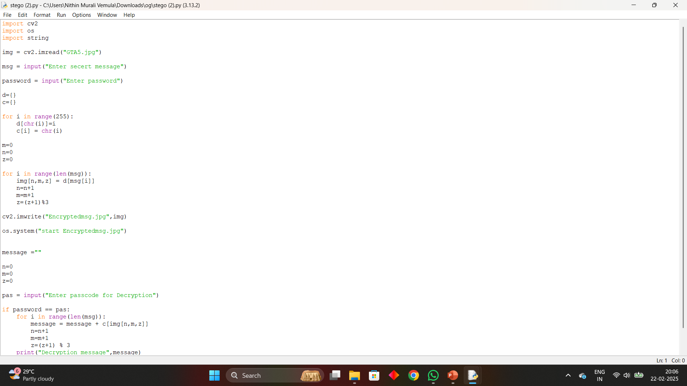
Results

Slide 8
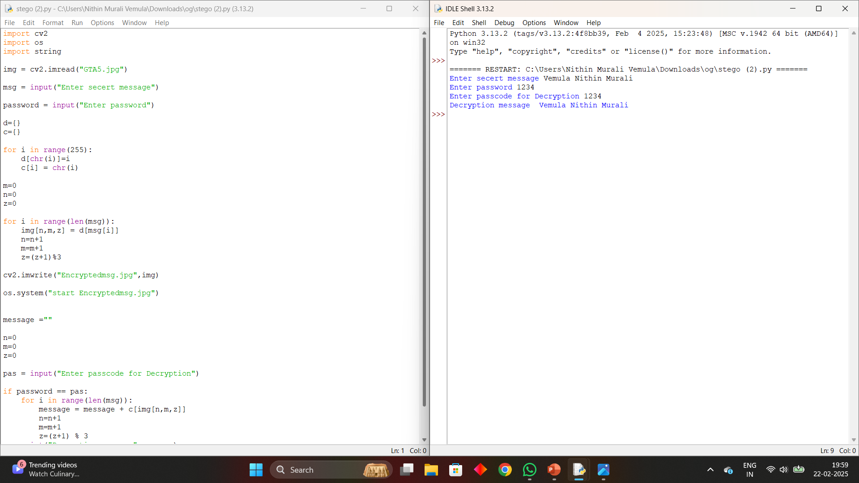

Slide 9


Slide 10
Conclusion
In conclusion, Secure Data Hiding in Images Using Steganography offers a powerful and discreet method for transmitting sensitive information in an era where privacy and security are paramount. By embedding data within digital images, steganography allows for the secure concealment of messages or files, ensuring that unauthorized parties remain unaware of the existence of the hidden data. This technology provides a unique combination of security, invisibility, and robustness that is crucial for a wide range of applications, from secure communication and intellectual property protection to safeguarding personal data.
The process of securely hiding information in images involves carefully balancing the need for data capacity with maintaining the integrity and quality of the original image. The future of steganography lies in continuous improvements to encryption techniques, detection evasion methods, and the ability to resist tampering or image manipulations. Moreover, with the integration of emerging technologies such as artificial intelligence, blockchain, and quantum-resistant cryptography, the potential for steganography systems to offer even more secure and efficient solutions grows.

Slide 11
GitHub Link
https://github.com/NithinMurali-code/SECURE-DATA-HIDING-IN-IMAGES-USING-STEGANOGRAPHY.git

Slide 12
Future scope(optional)
The future scope for Secure Data Hiding in Images Using Steganography is vast and dynamic, driven by the evolving demands for privacy, security, and data integrity in the digital world. Below are some key areas where advancements and innovations could occur:
1. Integration with Emerging Technologies
2. Improved Robustness Against Attacks
3. Larger Data Capacity with Minimal Distortion
4. Cross-Platform and Real-Time Steganography
5. Enhanced Security with Cryptography
6. Ethical and Legal Considerations
7. Steganography in Cloud Storage and IoT Devices
8. Detection and Countermeasures
9. User-Friendly Tools for Non-Experts

Slide 13
THANK YOU

